Slide 1
Upcoming schedule for MSEG 302
Tuesday, March 13th
HW #5 answers
HW #6 posted
Chapter 7 lecture
Thursday, March 15th
Exam Review by DCM
Practice Exams… but not the answers
Tuesday, March 20th
HW #6 answers
Discussions with TAs
Thursday, March 22nd
Exam I: Chapters 1-7, 14 from Callister

Slide 2
Chapter 7:
Dislocations & Strengthening Mechanisms
ISSUES TO ADDRESS...
• Why are dislocations observed primarily in metals
and alloys?
• How are strength and dislocation motion related?
• How do we increase strength?
• How can heating change strength and other properties?

Slide 3
Dislocations & Materials Classes
• Metals: Disl. motion easier.
-non-directional bonding
-close-packed directions
for slip.
+
+
+
+
+
+
+
+
+
+
+
+
+
+
+
+
+
+
+
+
+
+
+
+
electron cloud
ion cores
• Covalent Ceramics
(Si, diamond): Motion hard.
-directional (angular) bonding
• Ionic Ceramics (NaCl):
Motion hard.
-need to avoid ++ and - -
neighbors.
+
-
+
-
+
-
+
-
+
-
+
-
+
-
+
-
+
-
+
-
+

Slide 4
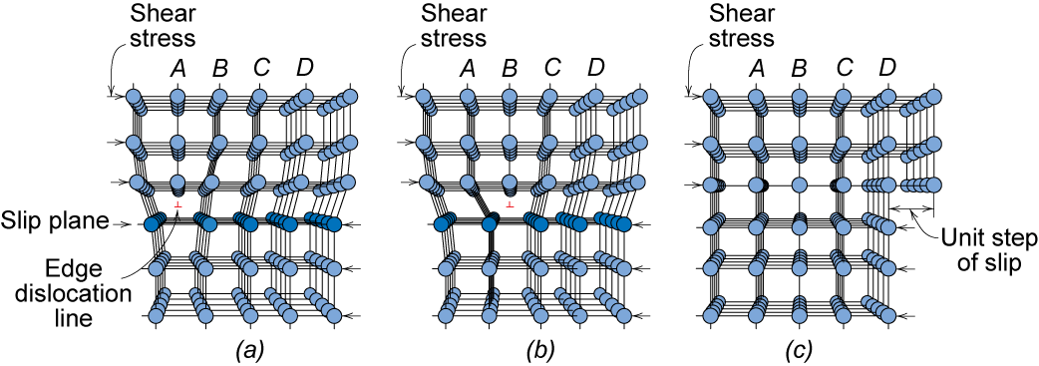
Dislocation Motion
Dislocations & plastic deformation
Cubic & hexagonal metals - plastic deformation by plastic shear or slip where one plane of atoms slides over adjacent plane by defect motion (dislocations).
If dislocations don't move,
plastic deformation doesn't occur!
Adapted from Fig. 7.1, Callister 7e.
Notes:
So we saw that above the yield stress plastic deformation occurs. But how? In a perfect single crystal for this to occur every bond connecting tow planes would have to break at once! Large energy requirement
Now rather than entire plane of bonds needing to be broken at once, only the bonds along dislocation line are broken at once.

Slide 5
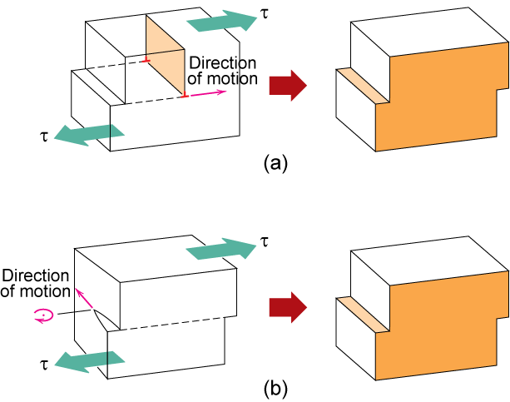
Dislocation Motion
Dislocation moves along slip plane in slip direction perpendicular to dislocation line
Slip direction same direction as Burgers vector
Edge dislocation
Screw dislocation

Slide 6
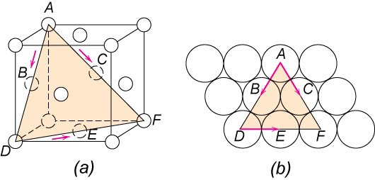
Deformation Mechanisms
Slip System
  Slip plane - plane allowing easiest slippage
    Wide interplanar spacings - highest planar densities
  Slip direction - direction of movement - Highest linear densities
  FCC Slip occurs on {111} planes (close-packed) in <110> directions (close-packed)
    => total of 12 slip systems in FCC
  in BCC & HCP other slip systems occur

Slide 7
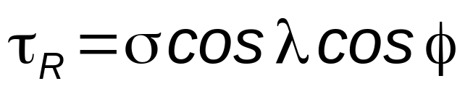
Stress and Dislocation Motion
• Crystals slip due to a resolved shear stress, τ_{R}.
• Applied tension can produce such a stress.
Applied tensile
Resolved shear
Relation between
stress:
σ
= F/A
stress:
τ_{R}
=
F
s
/A
s
σ
and
τ_{R}
F
slip plane
normal, n_{s}
τ_{R}
A
τ_{R}
=
F_{S}
/A_{S}
A_{S}
F
cos
λ
A
/
cos
φ
F_{S}
F
n_{S}
φ
slip
direction
λ
slip
direction
A
τ_{R}
F_{S}
A_{S}
F
slip
direction

Slide 8
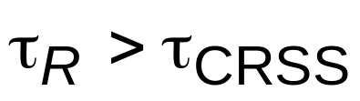

Critical Resolved Shear Stress
• Condition for dislocation motion:
• Crystal orientation can make
it easy or hard to move dislocation
typically
10⁻⁴ GPa to 10⁻² GPa
σ
σ
σ
τ_{R}
= 0
τ_{R}
=
σ
/2
τ_{R}
= 0
λ
=90°
λ
=45°
φ
=90°
φ
=45°
τ maximum at λ = φ = 45º

Slide 9
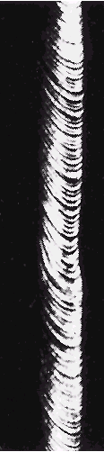
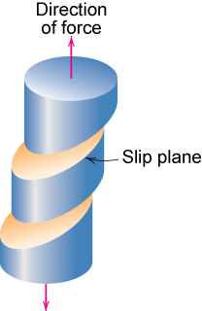
Single Crystal Slip
Adapted from Fig. 7.9, Callister 7e.
Adapted from Fig. 7.8, Callister 7e.

Slide 10
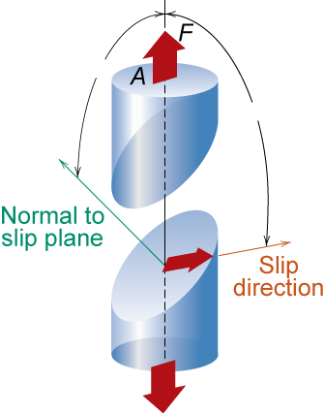
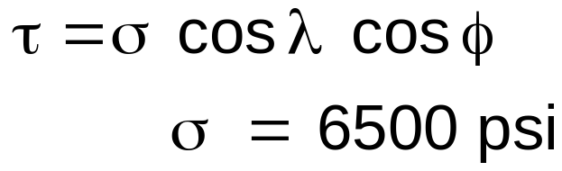
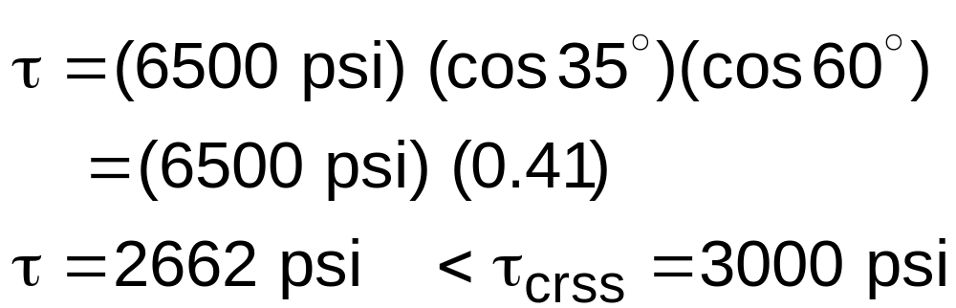
Ex: Deformation of single crystal
a) Will the single crystal yield?
b) If not, what stress is needed?
φ=60°
τ_{crss} = 3000 psi
λ=35°
Adapted from Fig. 7.7, Callister 7e.
σ = 6500 psi
So the applied stress of 6500 psi will not cause the crystal to yield.

Slide 11
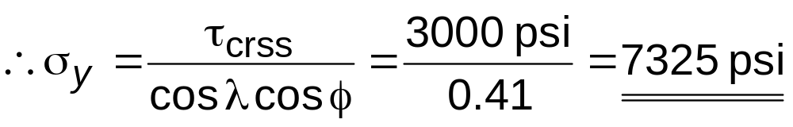
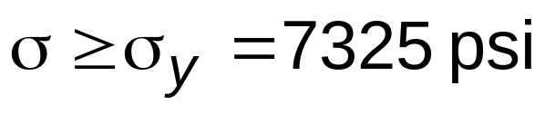
Ex: Deformation of single crystal
What stress is necessary (i.e., what is the yield stress, σ_{y})?
So for deformation to occur the applied stress must be greater than or equal to the yield stress

Slide 12
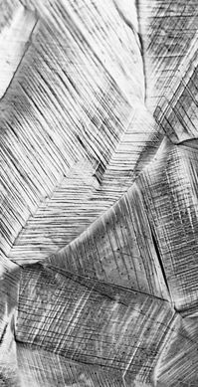
Slip Motion in Polycrystals
σ
• Stronger - grain boundaries
pin deformations
• Slip planes & directions
(λ, φ) change from one
crystal to another.
• τ_{R} will vary from one
crystal to another.
• The crystal with the
largest τ_{R} yields first.
• Other (less favorably
oriented) crystals
yield later.
Adapted from Fig. 7.10, Callister 7e.
(Fig. 7.10 is courtesy of C. Brady, National Bureau of Standards [now the National Institute of Standards and Technology, Gaithersburg, MD].)
300 μm

Slide 13
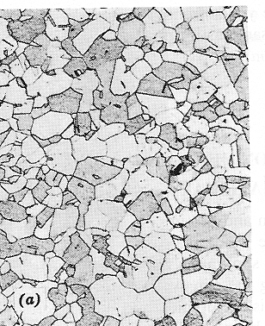
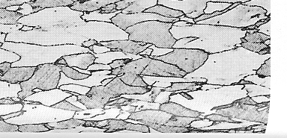
Anisotropy in σ_{y}
• Can be induced by rolling a polycrystalline metal
- before rolling
- after rolling
rolling direction
235 μm
- isotropic
since grains are
approx. spherical
& randomly
oriented.
- anisotropic
since rolling affects grain
orientation and shape.

Slide 14
Strengthening Strategies
1. Grain Size
2. Alloying
3. Precipitates
4. Dislocations

Slide 15
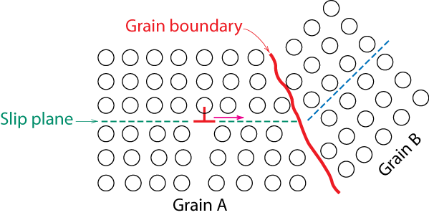
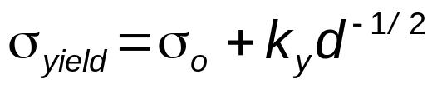
4 Strategies for Strengthening:
1: Reduce Grain Size
• Grain boundaries are
barriers to slip.
• Barrier "strength"
increases with
Increasing angle of
misorientation.
• Smaller grain size:
more barriers to slip.
• Hall-Petch Equation:
Adapted from Fig. 7.14, Callister 7e.
(Fig. 7.14 is from A Textbook of Materials Technology, by Van Vlack, Pearson Education, Inc., Upper Saddle River, NJ.)

Slide 16
4 Strategies for Strengthening:
2: Solid Solutions
• Impurity atoms distort the lattice & generate stress.
• Stress can produce a barrier to dislocation motion.
• Smaller substitutional
impurity
• Larger substitutional
impurity
A
C
B
D
Impurity generates local stress at A and B that opposes dislocation motion to the right.
Impurity generates local stress at C and D that opposes dislocation motion to the right.

Slide 17
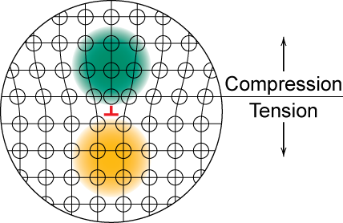
Stress Concentration at Dislocations
Adapted from Fig. 7.4, Callister 7e.
Notes:
Don’t move past one another – hardens material

Slide 18
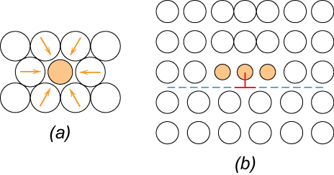
Strengthening by Alloying
small impurities tend to concentrate at dislocations
reduce mobility of dislocation ∴ increase strength

Slide 19
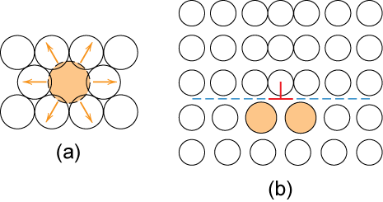
Strengthening by alloying
large impurities concentrate at dislocations on low density side

Slide 20
Ex: Solid Solution
Strengthening in Copper
• Tensile strength & yield strength increase with wt% Ni.
180
400
120
Tensile strength (MPa)
Yield strength (MPa)
300
200
60
0
10
20
30
40
50
0
10
20
30
40
50
wt.% Ni, (Concentration C)
wt.%Ni, (Concentration C)
• Alloying typically increases σ_{y} and TS.

Slide 21
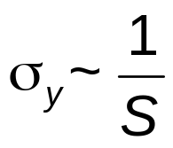
4 Strategies for Strengthening:
3: Precipitation Strengthening
• Hard precipitates are difficult to shear.
Ex: Ceramics in metals (SiC in Iron or Aluminum).
precipitate
Large shear stress needed
Side View
to move dislocation toward
precipitate and shear it.
Top View
Unslipped part of slip plane
Dislocation
“advances” but
precipitates act as
S
“pinning” sites with
spacing
spacing
S
.
Slipped part of slip plane
• Result:

Slide 22

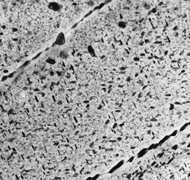
Application:
Precipitation Strengthening
• Internal wing structure on Boeing 767
• Aluminum is strengthened with precipitates formed
by alloying.
1.5μm

Slide 23
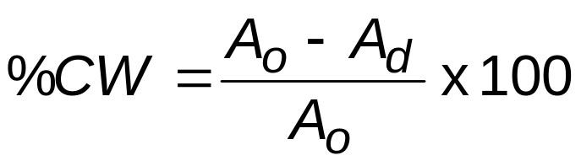
4 Strategies for Strengthening:
4: Cold Work (%CW)
• Room temperature deformation.
• Common forming operations change the cross
sectional area:
-Forging
force
-Rolling
die
roll
A
d
A
o
blank
A
d
A
o
Adapted from Fig. 11.8, Callister 7e.
roll
-Drawing
force
-Extrusion
A
o
die
A
d
container
die holder
A
tensile
force
o
force
ram
billet
extrusion
A
d
die
container
die

Slide 24
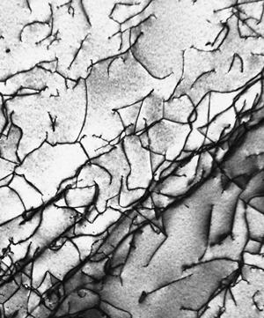
Dislocations During Cold Work
• Ti alloy after cold working:
• Dislocations multiply and entangle with one another during cold work.
• Dislocation motion becomes more difficult.
0.9 μm

Slide 25
Result of Cold Work
total dislocation length
Dislocation density =
  Carefully grown single crystal
  → ca. 10³ mm⁻²
  Deforming sample increases density
  → 10⁹-10¹⁰ mm⁻²
  Heat treatment reduces density
  → 10⁵-10⁶ mm⁻²
unit volume
σ
• Yield stress increases
as ρ_{d} increases:
σ
y1
large hardening
σ
y0
small hardening
ε
Notes:
Again it propagates through til reaches the edge

Slide 26
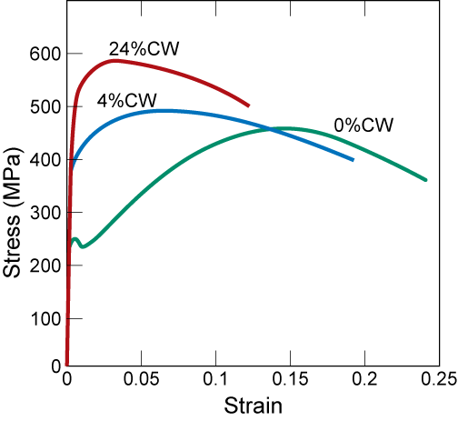
Impact of Cold Work
As cold work is increased
• Yield strength (σ_{y}) increases.
• Tensile strength (TS) increases.
• Ductility (%EL or %AR) decreases.

Slide 27
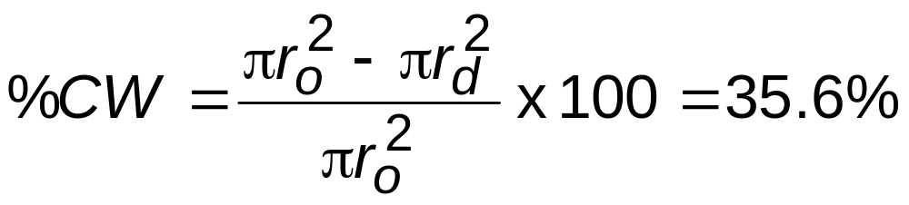
Cold Work Analysis
• What is the tensile strength &
ductility after cold working?
Copper
Cold
Work
D
o
=15.2mm
D
d
=12.2mm
yield strength (MPa)
tensile strength (MPa)
ductility (%EL)
60
700
800
500
600
40
300MPa
Cu
300
Cu
400
20
340MPa
Cu
100
7%
0
20
40
60
200
0
20
40
60
0
0
20
40
60
% Cold Work
% Cold Work
% Cold Work
σ
y
= 300MPa
TS = 340MPa
%EL
= 7%

Slide 28
σ- ε Behavior vs. Temperature
800
• Results for
polycrystalline iron:
-200°C
600
-100°C
Stress (MPa)
400
25°C
200
0
0
0.1
0.2
0.3
0.4
0.5
Strain
• σ_{y} and TS decrease with increasing test temperature.
• %EL increases with increasing test temperature.
• Why? Vacancies
help dislocations
move past obstacles.
3
. disl. glides past obstacle
2. vacancies
replace
atoms on the
disl. half
obstacle
plane
1. disl. trapped
by obstacle

Slide 29
Effect of Heating After %CW
• 1 hour treatment at T_{anneal}...
decreases TS and increases %EL.
• Effects of cold work are reversed!
annealing temperature (ºC)
100
200
300
400
500
600
700
600
60
tensile strength
50
500
• 3 Annealing
stages to
discuss...
ductility (%EL)
tensile strength (MPa)
40
400
30
ductility
20
300
Recovery
Grain Growth
Recrystallization

Slide 30
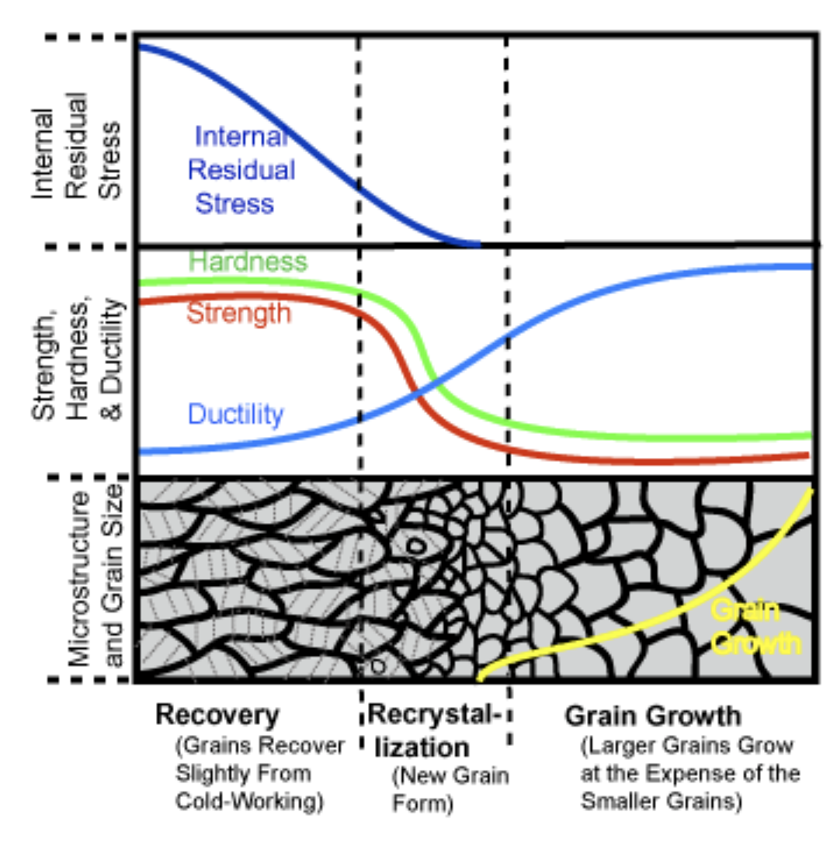

Slide 31
Recovery
Annihilation reduces dislocation density.
• Scenario 1
extra half-plane
Results from diffusion
of atoms
Dislocations
atoms
annihilate
diffuse
and form
to regions
a perfect
of tension
atomic
extra half-plane
plane.
of atoms
• Scenario 2
τ_{R}
3
. “Climbed” disl. can now
move on new slip plane
2
. grey atoms leave by
vacancy diffusion
4. opposite dislocations
allowing disl. to “climb”
meet and annihilate
1. dislocation blocked;
Obstacle dislocation
can’t move to the right

Slide 32
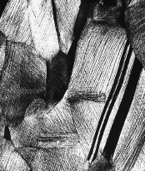
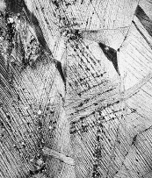
Recrystallization
• New grains are formed that:
-- have a small dislocation density
-- are small
-- consume cold-worked grains.
0.6 mm
0.6 mm
33% cold
worked
brass
New crystals
nucleate after
3 sec. at 580°C.

Slide 33
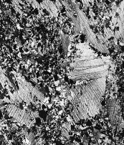
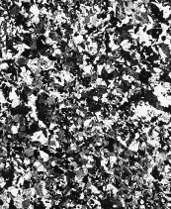
Further Recrystallization
• All cold-worked grains are consumed.
0.6 mm
0.6 mm
After 4
seconds
After 8
seconds

Slide 34
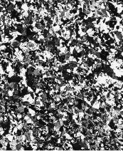
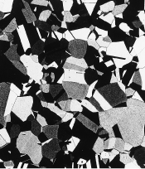
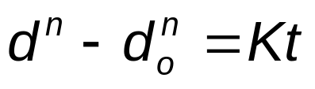
Grain Growth
• At longer times, larger grains consume smaller ones.
• Why? Grain boundary area (and therefore energy)
is reduced.
0.6 mm
0.6 mm
After 8 s,
580ºC
After 15 min,
580ºC
coefficient dependent
on material and T.
• Empirical Relation:
exponent typ. ~ 2
grain diam.
at time t.
elapsed time

Slide 35
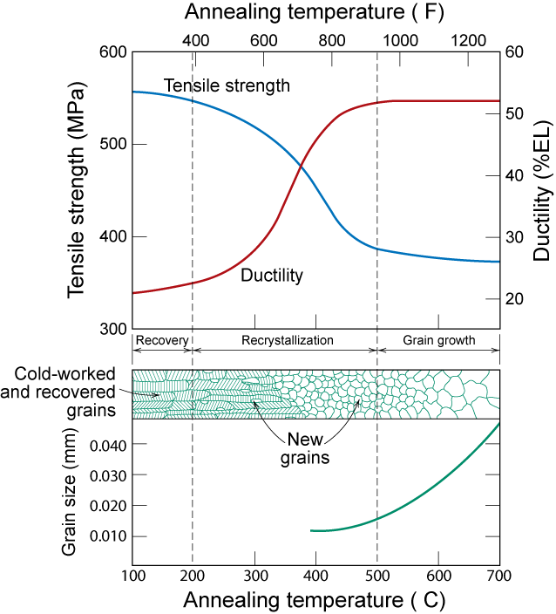
º
T_{R} = recrystallization
temperature
T_{R}=0.33 to 0.5 Tm
T_{R}
Adapted from Fig. 7.22, Callister 7e.
º

Slide 36
Recrystallization Temperature, T_{R}
T_{R} = recrystallization temperature = when process complete in one hour; near point where properties change dramatically
  T_{m} => T_{R} ≈ 0.33-0.5 T_{m} (K)
  Due to diffusion → annealing time→ T_{R} = f(t) shorter annealing time => higher T_{R}
  Higher %CW => lower T_{R} – strain hardening
    Some critical amount of CW typically needed, ~5%
  Pure metals lower T_{R} due to dislocation movements, grain boundary segregation in alloys
    Easier to move in pure metals => lower T_{R}

Slide 37
Coldwork Calculations
A cylindrical rod of brass originally 0.40 in (10.2 mm) in diameter is to be cold worked by drawing. The circular cross section will be maintained during deformation. A cold-worked tensile strength in excess of 55,000 psi (380 MPa) and a ductility of at least 15 %EL are desired. Further more, the final diameter must be 0.30 in (7.6 mm). Explain how this may be accomplished.

Slide 38
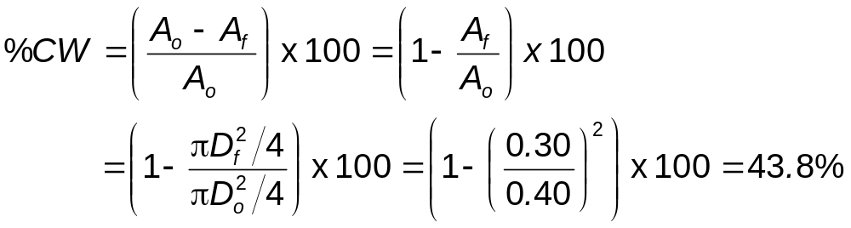
Coldwork Calculations Solution
If we directly draw to the final diameter what happens?
Brass
Cold
Work
D
o
= 0.40 in
D
f
= 0.30 in

Slide 39
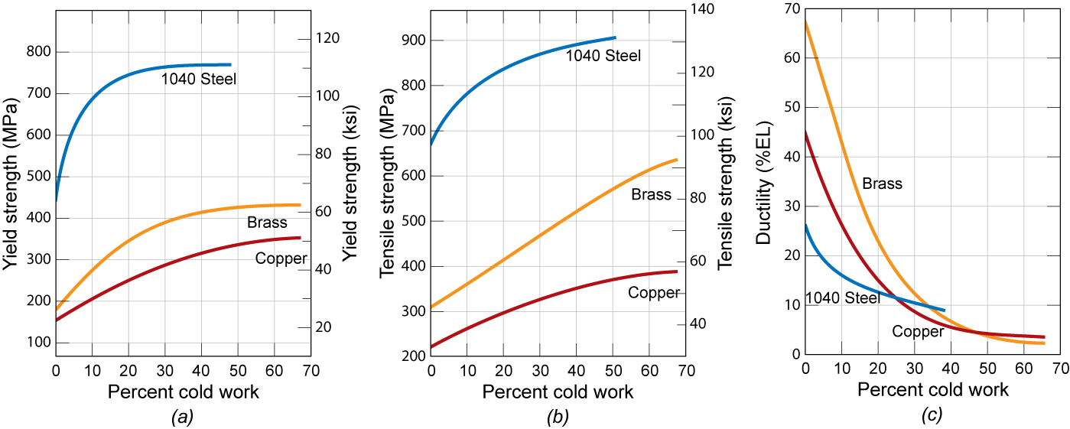
Coldwork Calc Solution: Cont.
420
540
6
For %CW = 43.8%
  σ_{y} = 420 MPa
  TS = 540 MPa > 380 MPa
  %EL = 6 < 15
This doesn’t satisfy criteria…… what can we do?

Slide 40
Coldwork Calc Solution: Cont.
380
15
12
27
Adapted from Fig. 7.19, Callister 7e.
For TS > 380 MPa
> 12 %CW
For %EL > 15
< 27 %CW
∴ our working range is limited to %CW = 12-27

Slide 41
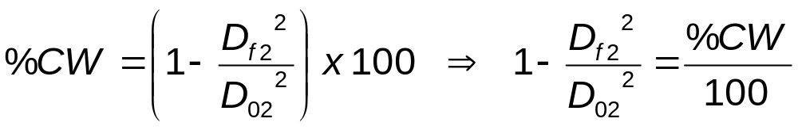
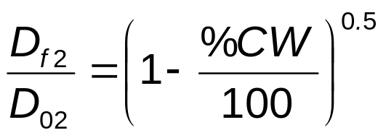
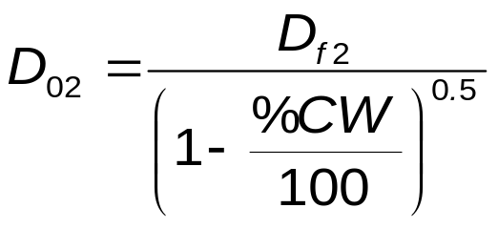
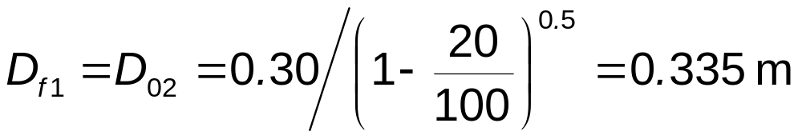
Coldwork Calc Soln: Recrystallization
Cold draw-anneal-cold draw again
For objective we need a cold work of %CW ≅ 12-27
  We’ll use %CW = 20
Diameter after first cold draw (before 2nd cold draw)?
  must be calculated as follows:
⇒
Intermediate diameter =
Notes:
So after the cold draw & anneal D₀₂=0.335m

Slide 42
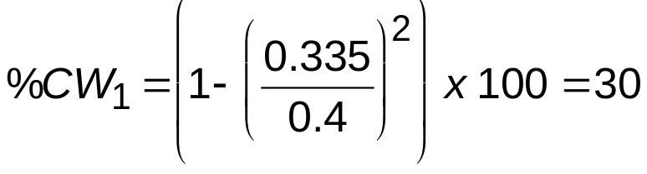
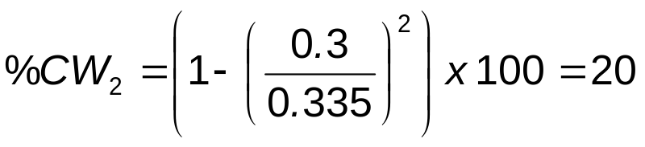
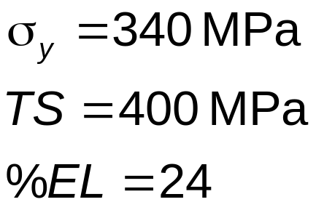
Coldwork Calculations Solution
Summary:
Cold work D₀₁= 0.40 in → D_{f1} = 0.335 m
Anneal above T_{R} D₀₂ = D_{f1}
Cold work D₀₂= 0.335 in → D_{f 2} =0.30 m
Therefore, meets all requirements
Fig 7.19
⇒

Slide 43
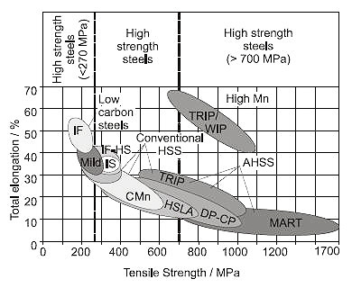
Ductility and Strength: steels

Slide 44
Summary
• Dislocations are observed primarily in metals
and alloys.
• Strength is increased by making dislocation
motion difficult.
• Particular ways to increase strength are to:
--decrease grain size
--solid solution strengthening
--precipitate strengthening
--cold work
• Heating (annealing) can reduce dislocation density
and increase grain size. This decreases the strength.

Slide 45
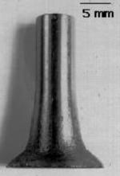
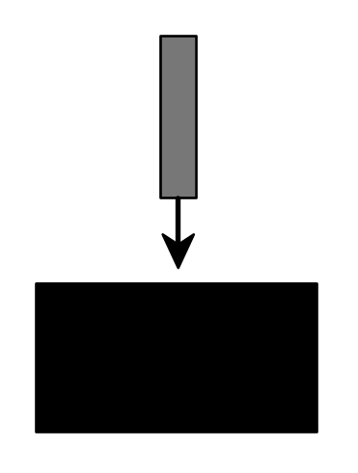
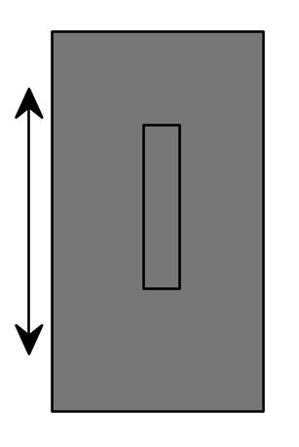
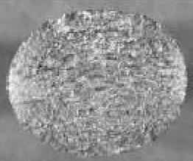
Anisotropy in Deformation
1. Cylinder of
Tantalum
machined
from a
rolled plate:
2. Fire cylinder
at a target.
3. Deformed
cylinder
Photos courtesy
of G.T. Gray III,
Los Alamos
National Labs. Used with
permission.
side view
rolling direction
end
view
plate
thickness
direction
• The noncircular end view shows
anisotropic deformation of rolled material.

Slide 46
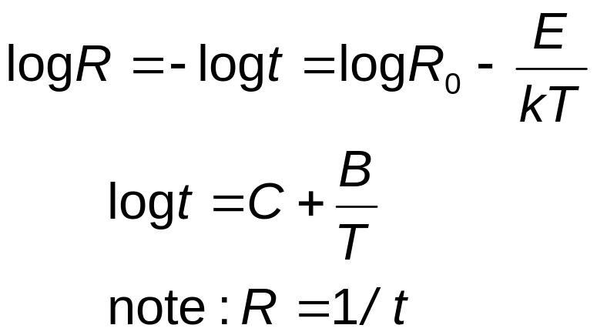

Rate of Recrystallization
Hot work → above T_{R}
Cold work → below T_{R}
Smaller grains
  stronger at low temperature
  weaker at high temperature
50%
start
finish
log t

